Slide 1
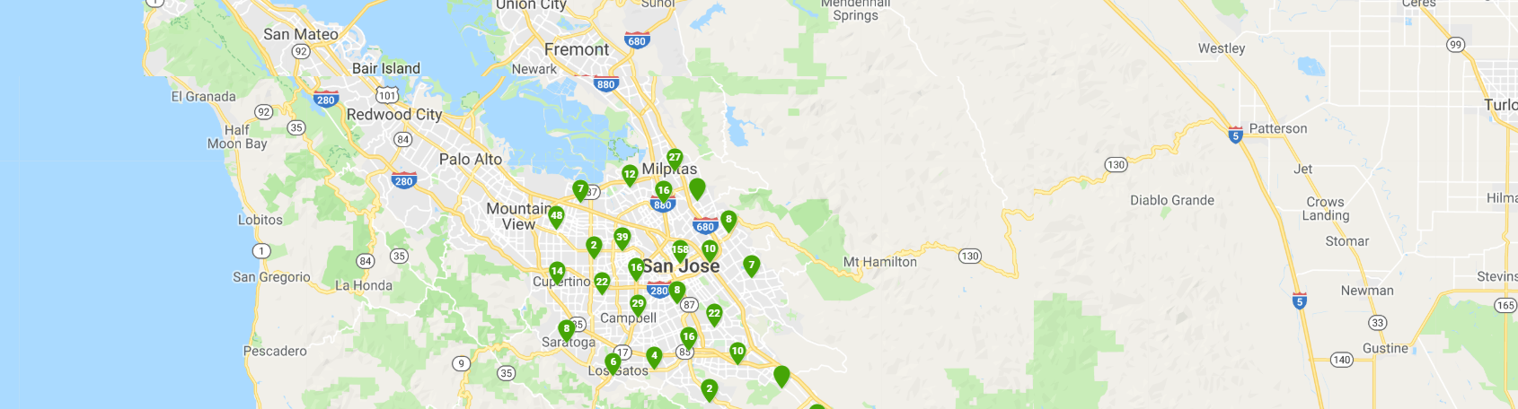
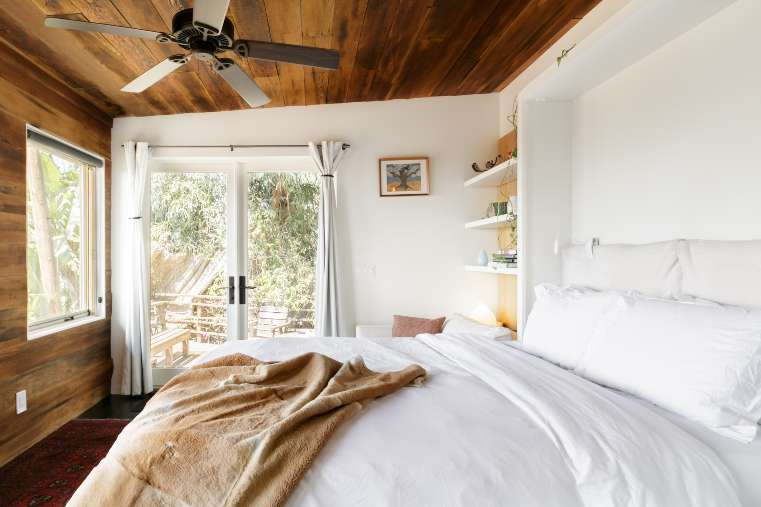
Listing
Price
Available
Location
Contact
$2000/month
Feb/20/2019
793 praderia circle, Fremont,ca, 94539
inseo.kr@gmail.com
Deposit:$1000
5104748138
$2000/month
Feb/20/2019
793 praderia circle, Fremont,ca, 94539
inseo.kr@gmail.com
Deposit:$1000
5104748138

